Slide 1



Pipette Calibration Dashboard
View in Power BI
Last data refresh:
4/5/2024 6:36:32 AM UTC
Downloaded at:
5/26/2024 2:23:15 AM UTC

Slide 2
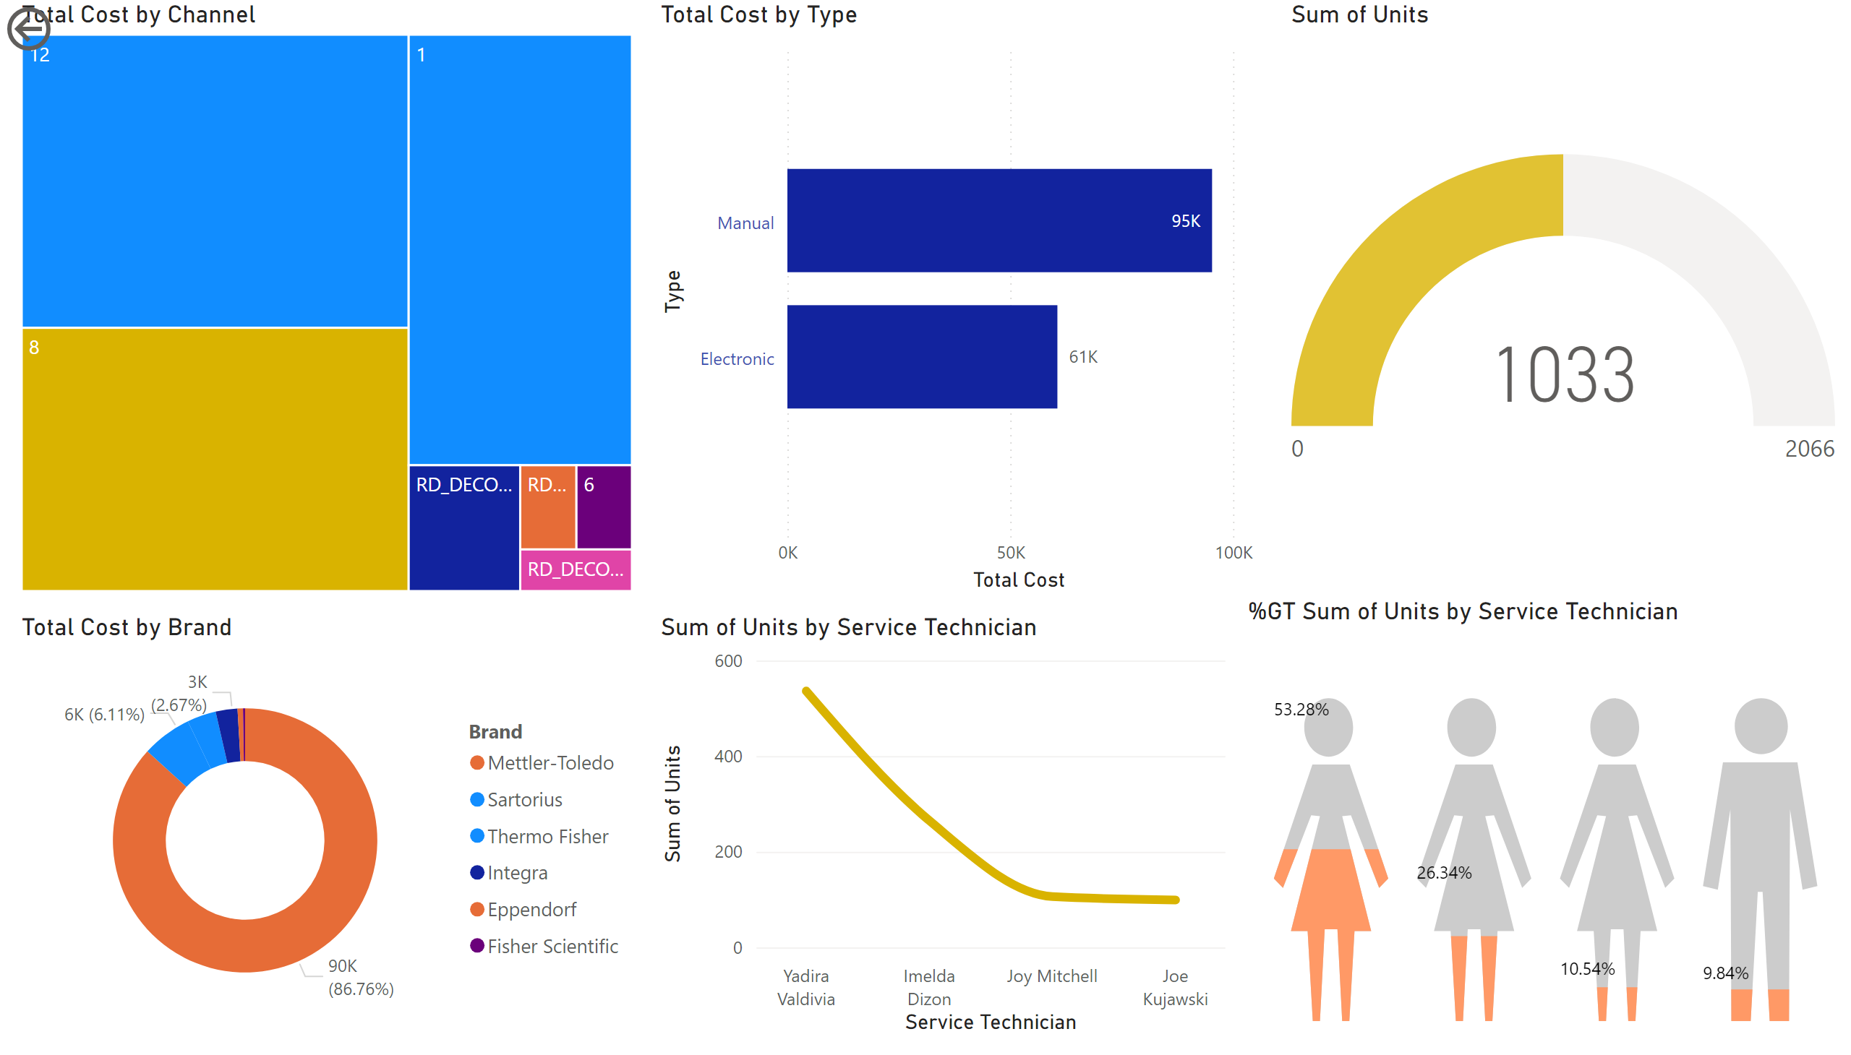
Page 1
Notes:
treemap
No alt text provided
clusteredBarChart
No alt text provided
actionButton
No alt text provided
donutChart
No alt text provided
gauge
No alt text provided
lineChart
No alt text provided
PBI_CV_73744D90_4DC9_4F18_8BA5_EE8FA5C98035
No alt text provided

